Slide 1
Agentic AI Foundations
Anshaj Khare
Notes:
Welcome to Fundamentals of Angentic AI - I’ll be your instructor: Anshaj Khare

Slide 2


Introduction – Anshaj Khare
I have been working on data science since 2017
I’ve worked for 4 startups before joining Microsoft
I have been working at Microsoft for 4+ years as a ML Engineer
In my career, I’ve worked as a backend engineer, a devops engineer, a data engineer and as a Machine learning engineer
Have taught over 4000+ learners - Python, Data Science and Gen AI
Author: https//compute.anshaj.dev/
Github: http://github.com/anshajk

Slide 3
Welcome to today’s class, before we begin,
pop into the chat:
Your Name
💬
👷
Role
👤
Location
🏠
🏢
Company
Notes:
Check how many students and adapt to typed in responses or poll, as needed

Slide 4


Optimize Your Experience
Interact with your instructors via Sunday live class.
Don’t be shy to speak up and get clarifications !
Solve your assignments, MCQs and other assessments and get feedback (Thursday review session)
Use your resources! It’s your experience – what you put in is what you’ll get out.

Slide 5



Before we start / How we got here
1970s – 1990s
2000s – 2010s
2020s
Rule-Based Systems
Machine Learning
Generative AI
If-then logic, expert systems,
hand-coded rules.
Learn patterns from data.
Classification, prediction, recs.
Generates text, code, images.
General-purpose & conversational.
Brittle, hard to maintain,
couldn't handle the unexpected.
Powerful but narrow
one model <-> one task.

Slide 6


And now GenAI is changing everything…
How
What
we build software
software we build
AI-assisted coding & code review
AI-native products & features
AI-driven testing & debugging
Conversational interfaces
AIOps -agents handling ops tasks
Agent-powered workflows

Slide 7
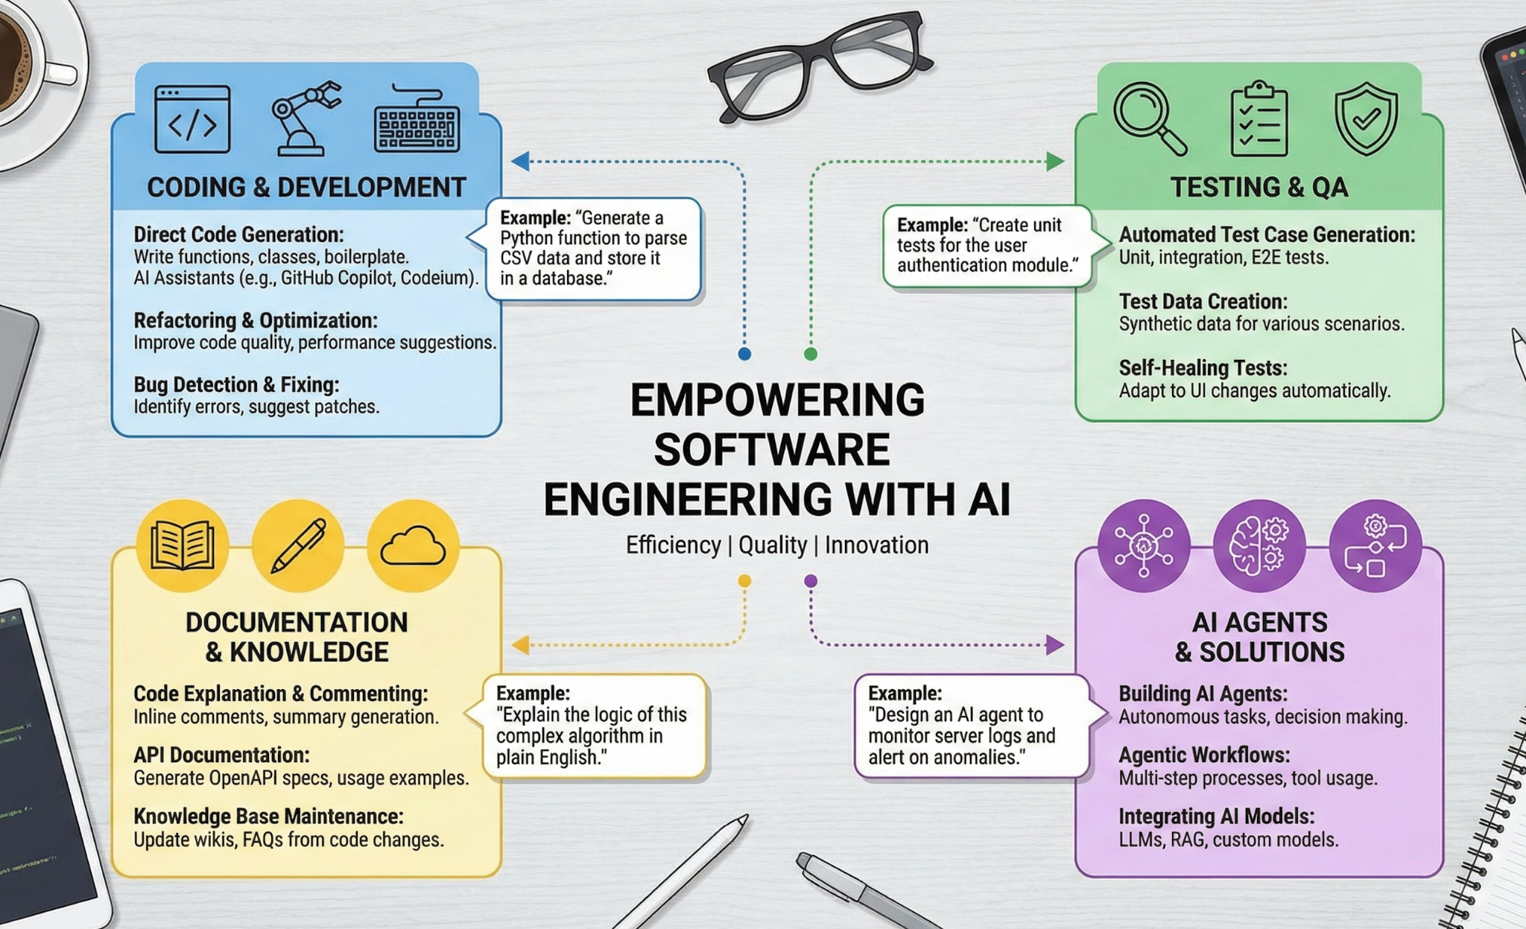
Before we begin…

Slide 8
From AI Tools to Agentic Systems: The Shift in Software Development
Agentic AI is shifting software development from tools that assist developers to systems that execute goals autonomously.
Instead of responding to single prompts, agents plan, decide, act, observe outcomes, and iterate.
The Shift Driven by Agentic AI:
  From static code → adaptive systems
  From function calls → decision-driven workflows
  From manual orchestration → autonomous execution

Slide 9
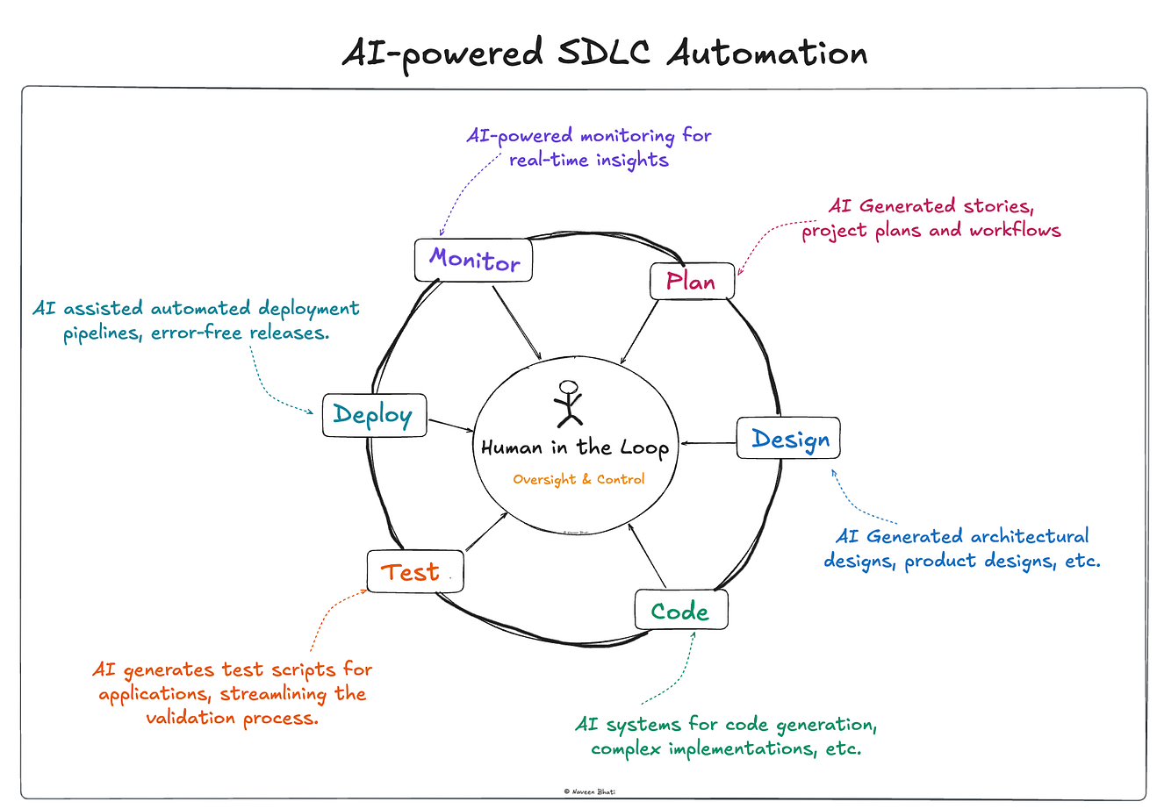
From AI Tools to Agentic Systems: The Shift in Software Development
The Entire SDLC Is Turning Into an AI-Driven Pipeline
AI plans requirements
Builds multi-file features
Runs tests automatically
Deploys & monitors continuously

Slide 10
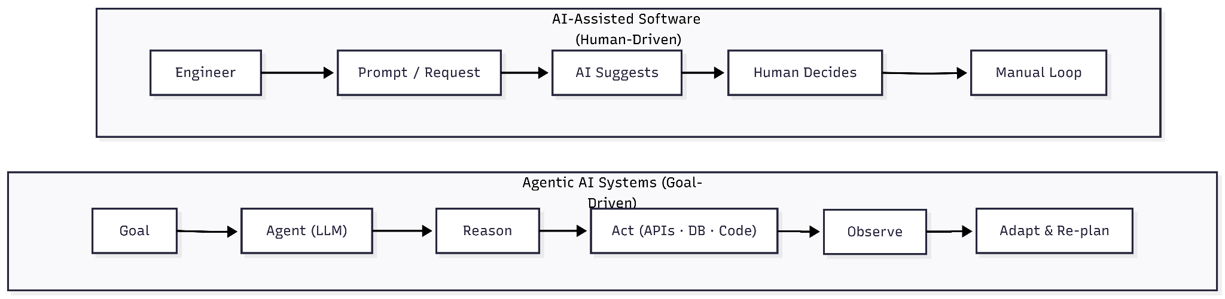
With execution responsibility delegated to agents, the focus shifts to what they can automate.

Slide 11
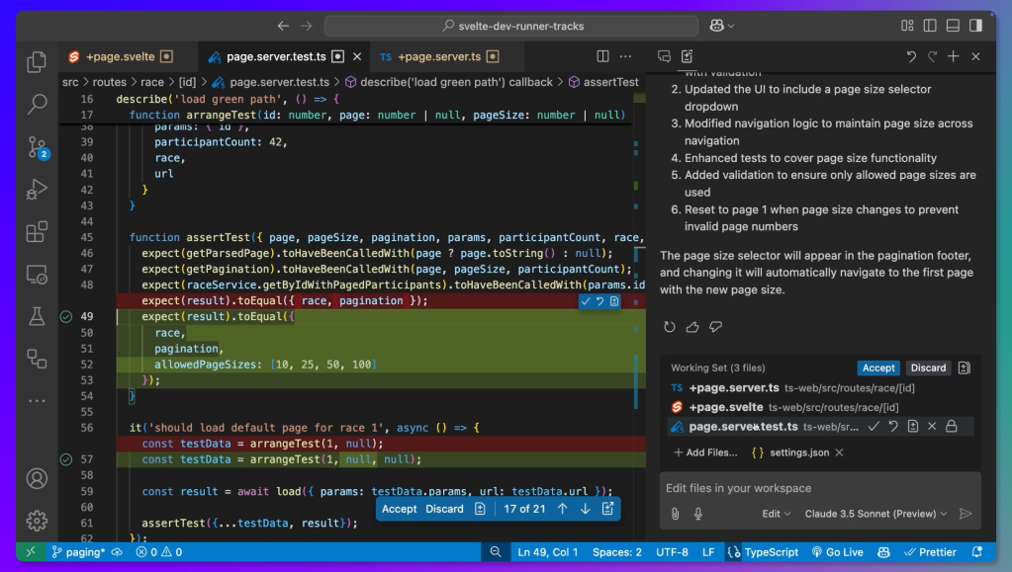
What Kind of AI Automations Are We Looking At?
GitHub Copilot agent mode that writes code autonomously, detects errors in real time, runs tests, and creates pull requests for review.

Slide 12
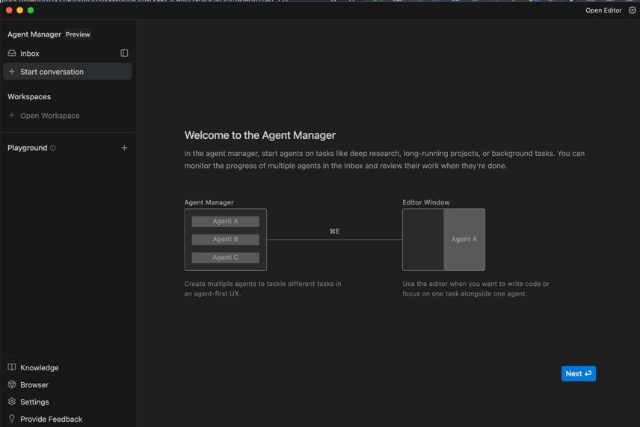
Google Antigravity IDE where multiple AI agents work in the editor and terminal to build apps, test code, and manage workflows inside a development environment.

Slide 13
Before we dive into Agents, let’s take a quick look at what this course will cover.

Slide 14
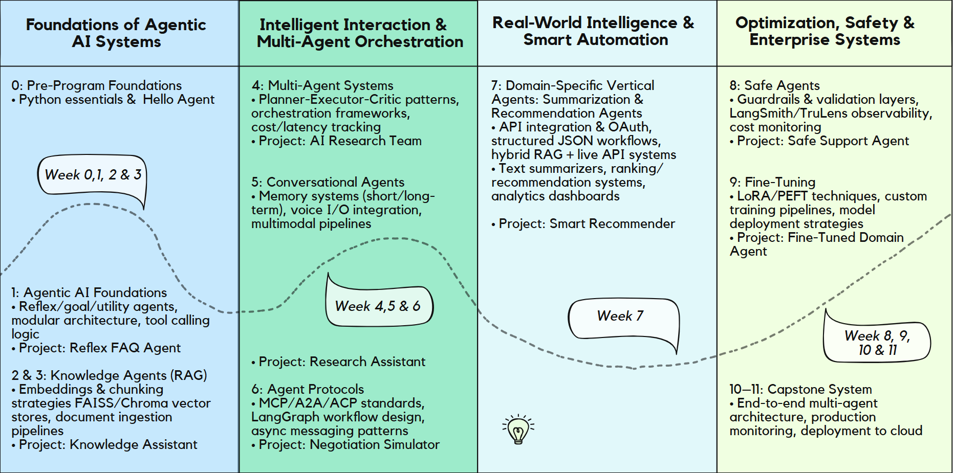
Agentic AI Program Structure

Slide 15
Detailed Curriculum & Upcoming Topics
Explore the detailed topic list for the upcoming weeks, including the key concepts, tools, and hands-on topics that will be covered in each module. This will help you understand the learning journey and prepare in advance.
https://docs.google.com/spreadsheets/d/1jnKR9t1CrOH91LmKndOmzvoCXRGNc1OOD9hb4ZfA_z8/edit?gid=0#gid=0

Slide 16
By the end of this course, you will be able to:
Build and deploy agents: from simple agents to multi-agent systems
Design agentic systems with real-world constraints and tradeoffs
Integrate agents into your existing tools and workflows
Ship production-ready agents with observability & evaluation
Fine-tune and tailor agentic systems for complex, domain-specific tasks

Slide 17
What You’ve Been Doing So Far: LLMs & Functions
The Shift Toward Agentic Systems
The Hidden Shift:
  LLMs + functions = daily workflow integration
  Intelligence + execution working together
  Foundation for agentic systems
This shift marks the transition to Agentic AI Systems.

Slide 18
What You’ll be learning today

Slide 19
Today’s Agenda
⭐
Break
Break
Break
Introduction to Gen AI and LLMs
Prompt Engineering
LLM-Based Agents
Q & A
1
2
3
4
Notes:
Why are these topics important?

Slide 20
Now, let’s get started

Slide 21
Generative AI (Gen AI)
Generating content with massive AI models

Slide 22

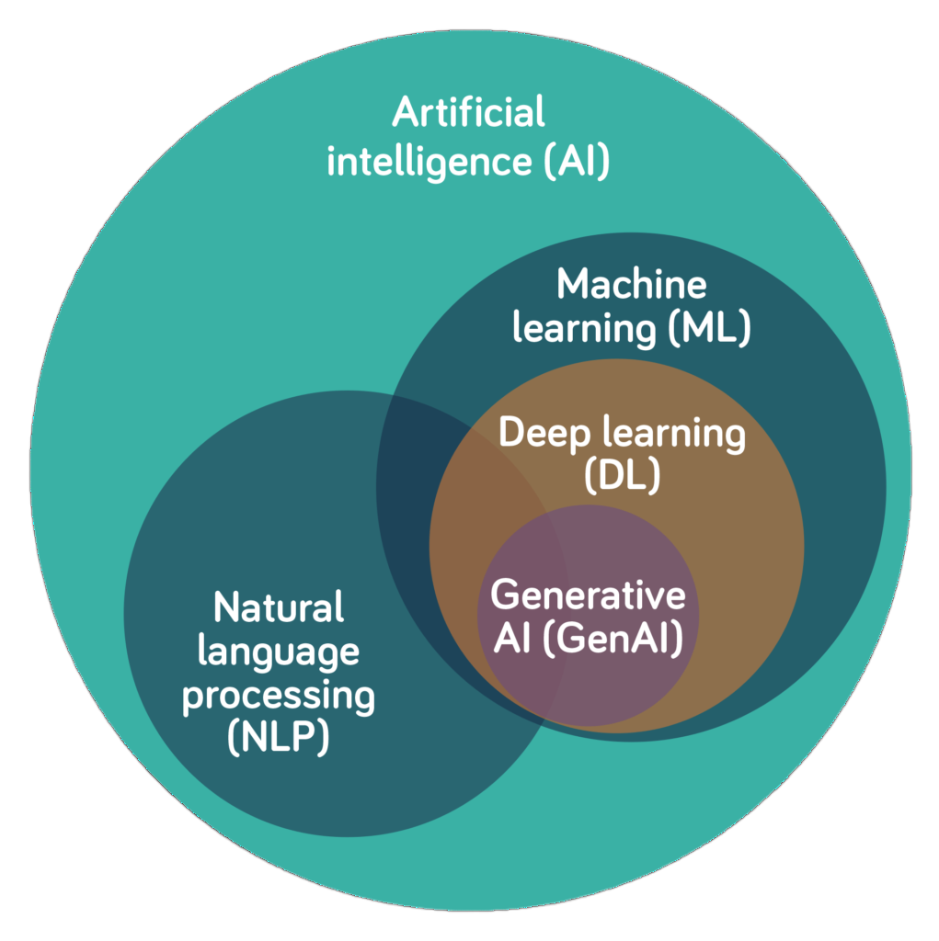
What is Gen AI?
Creates new content (text, code,
images, audio, video)
Understands natural language (and multimodal) inputs
Powered by large foundation models trained on massive datasets

Slide 23
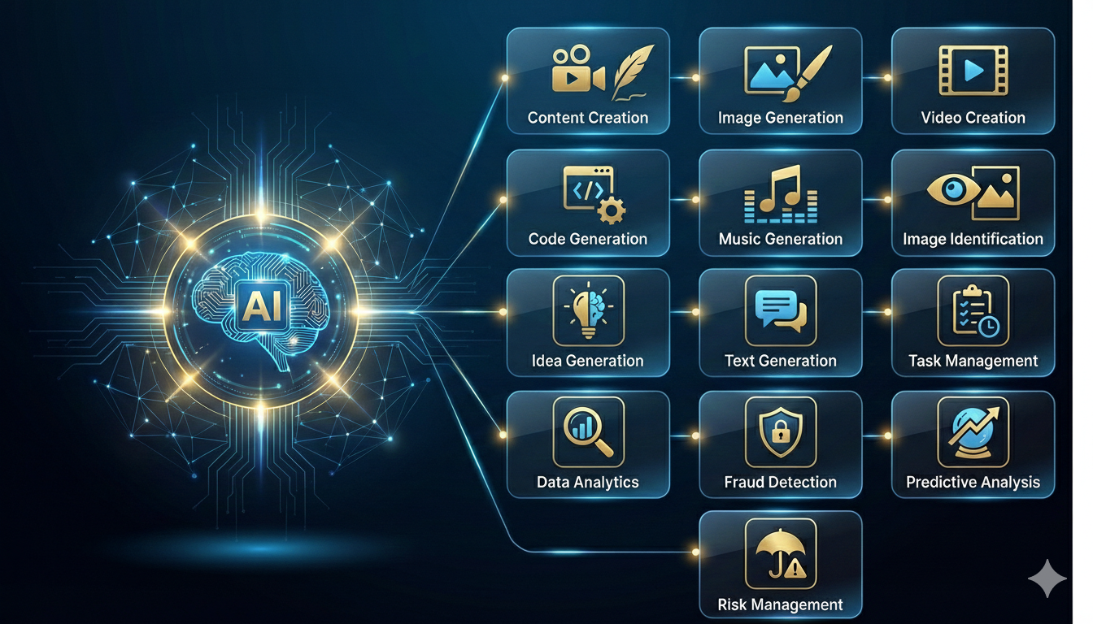
Use Cases of Gen AI

Slide 24
Behind most Generative AI system is a
Large Language Model (LLM)

Slide 25
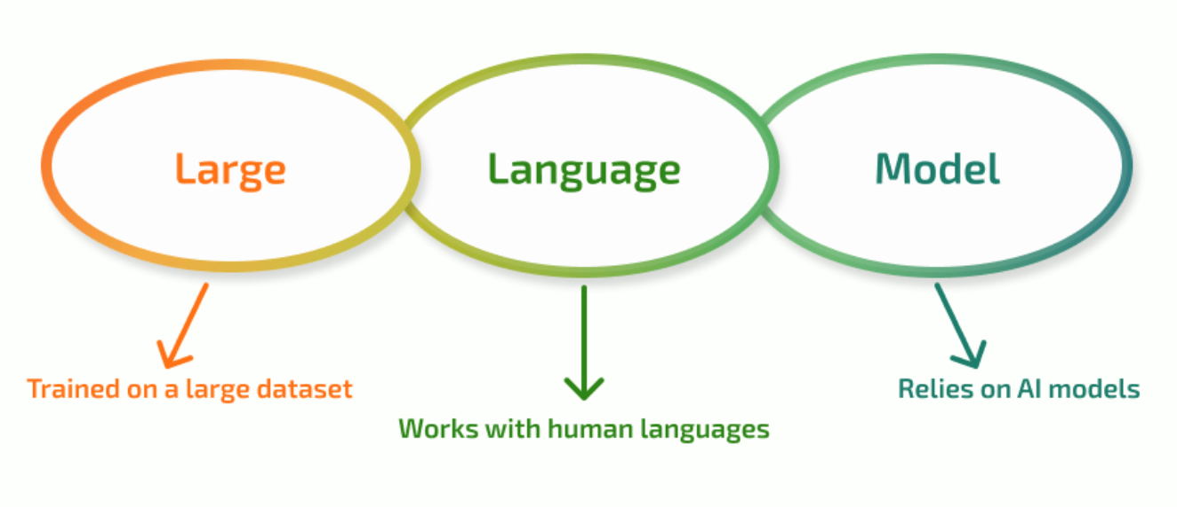
What are LLMs?
Trained on massive datasets to learn patterns, meaning, and reasoning
Understand and generate language and other modalities (text, code, images, audio)
Built on transformer architectures that scale to billions of parameters and long context

Slide 26
Calling LLMs via client libs

Slide 27


If LLMs are the engine,
prompts are how we steer them.
Prompt
LLM
The Steering
The Engine

Slide 28
Prompt Engineering
Context Set the stage: role, goal, plan etc.
"You are a senior SRE reviewing a post-mortem"
Structure Use delimiters, Markdown, or XML-like tags
Use ## Task, ## Input, ## Output headers to organize your prompt
Constraints Output format, tone, edge cases
Respond in JSON. Max 200 words. Use only the data provided.
Iterate Draft, evaluate, review output, refine.
## Role
You are a senior SRE reviewing
a post-mortem.
## Task
Summarize the root cause and
recommend 3 action items.
## Input
{incident report}
## Constraints
- Max 200 words
- Respond in JSON
- Use only the data provided

Slide 29
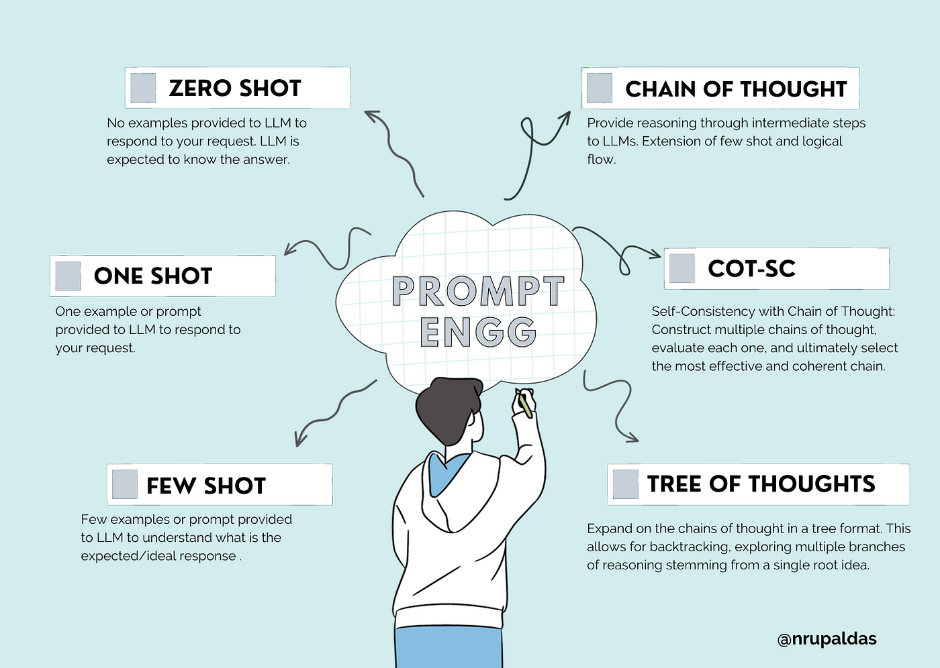
T
Y
P
E
S

Slide 30




Limitations of LLMs
No Fresh Knowledge
Hallucinations
Trained on a snapshot of the world. Can't access your docs, your databases, or what happened today.
Confidently wrong. No built-in way to verify or say "I don't know."
No Actions
No Memory
Generates text, not outcomes. Can't call an API, run a query, or update a ticket.
Every conversation starts from zero. No recall of past interactions or accumulated context.

Slide 31
What if we gave the LLM access to tools and a memory?

Slide 32
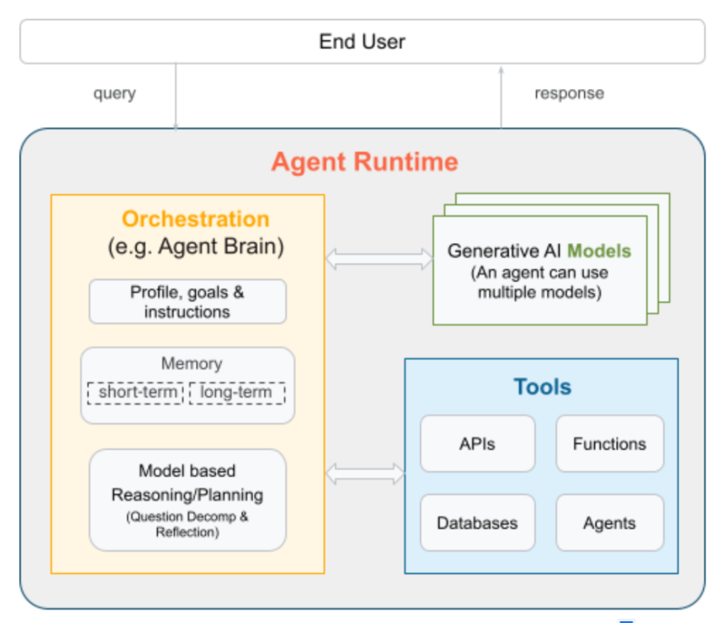



Agent = (Prompt + Tools + Memory) * LLM
An agent allows LLM to act, remember context, and decide what to do next.
Prompt
Defines the behavior
Tools
Enable actions
APIs, search, code execution, databases
Memory
Remembers between turns
https://neo4j.com/blog/agentic-ai/what-is-ai-agent/

Slide 33
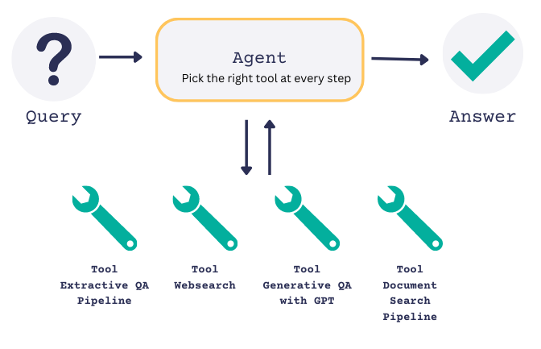
Agents and Tools
Tools turn LLMs from text generators into systems that can act.
Retrieve data from APIs, databases, or vector stores.
Execute actions in external systems, such as sending emails or calling web services.
Run deterministic logic, such as sorting, filtering, data transformation etc.

Slide 34
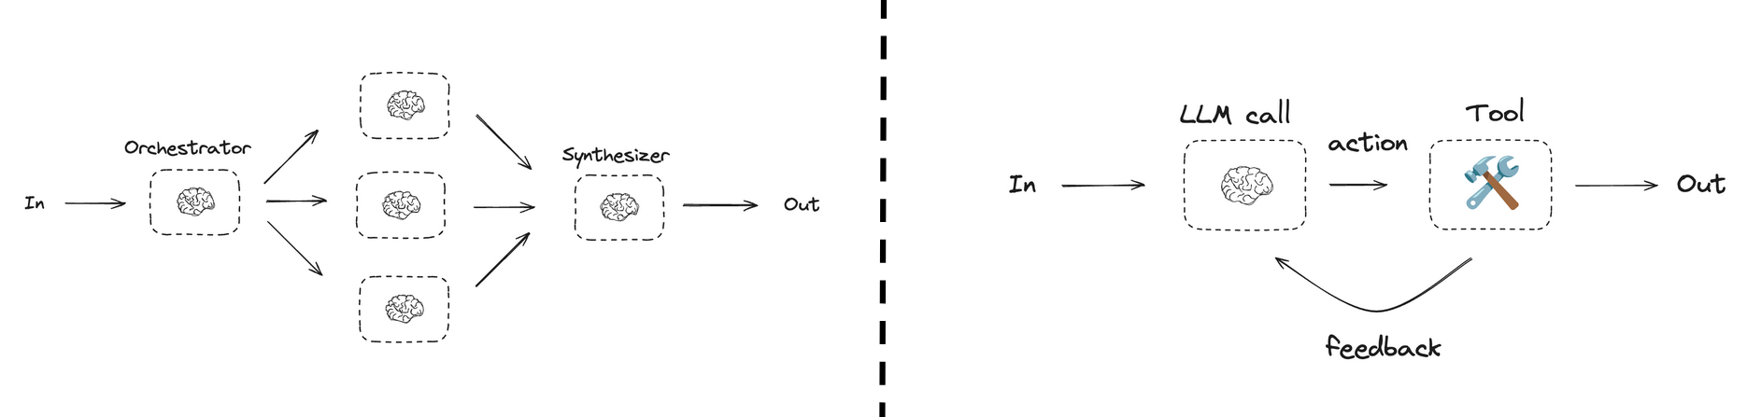
Who’s deciding what to do next?
Agentic Workflows
Autonomous Agents
LLM & tool control flow is programmatically defined.
The model dynamically
decides what to do next.
https://docs.langchain.com/oss/javascript/langgraph/workflows-agents

Slide 35

Workflows vs. Autonomous
 | 🔄 Autonomous | ⛓️ Workflow
Orchestration | LLM (dynamic) | Code (fixed pipeline)
Flexibility | High (adapts on the fly) | Low (predefined steps)
Predictability | Lower | Higher
Error handling | LLM reasons about it | Developer codes it
LLM calls | N (unknown ahead of time) | Fixed (known in advance)
Best for | Open-ended tasks | Well-defined processes
💡 In practice: Most production systems are hybrids: a workflow defines the high-level stages, but individual stages may use autonomous reasoning within a bounded scope.

Slide 36
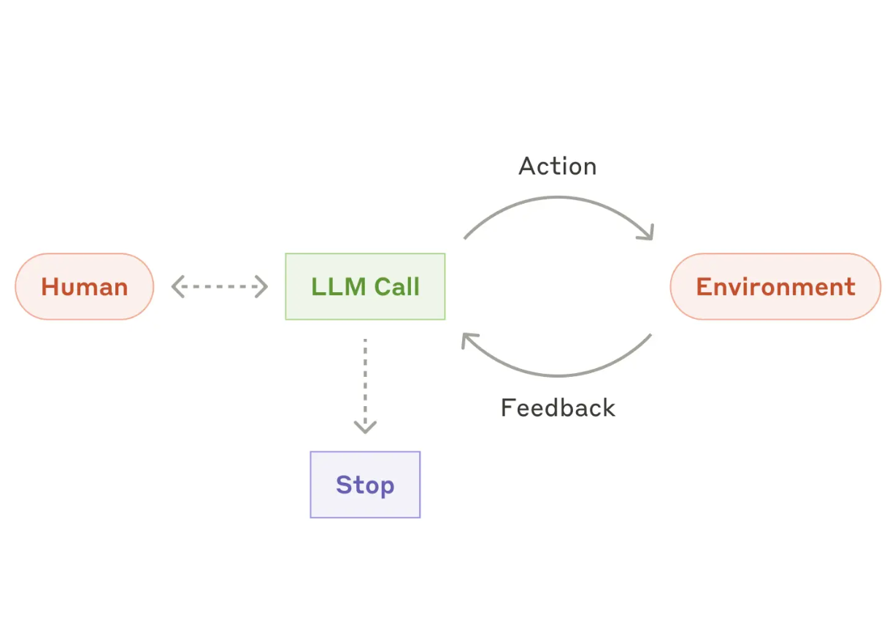
The Agent Loop = Loop(Think + Act + Observe)
Think
Act
Observe
https://www.anthropic.com/engineering/building-effective-agents

Slide 37
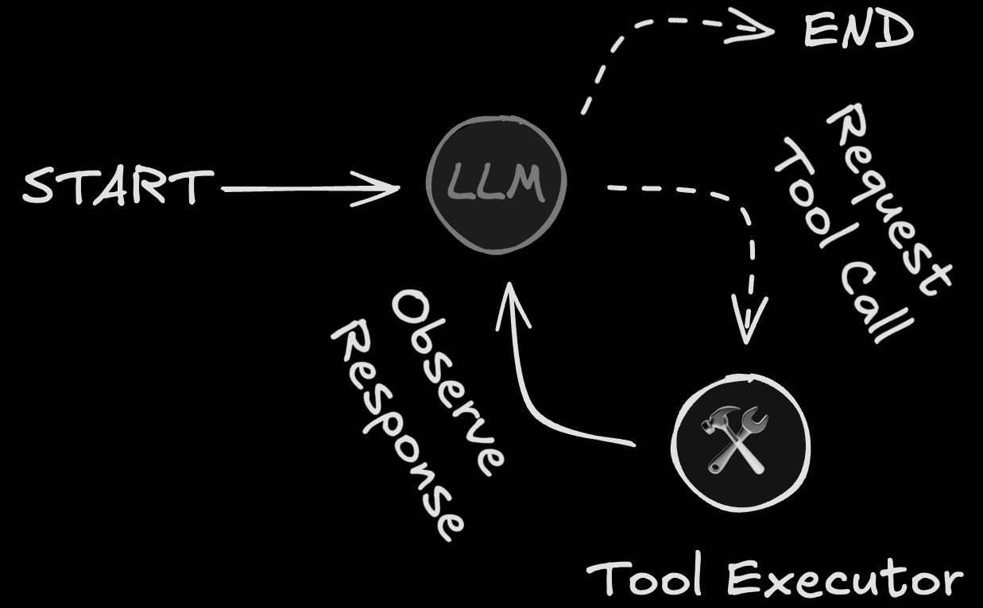
Agent’s way of solving problems - Example
Meeting scheduling agent
System prompt
“you are a scheduling assistant helping user book meetings”
Tool definitions
find_next_free_slot(from_date)
book_slot(start_time, duration)
user -> “book 30 mins on Feb 16”
// START
// THINK
1. I need to find next available slot for Feb 16.
// ACT
2. find_next_free_slot(“Feb 16”) -> 9am
// OBSERVE
3. Okay next available slot is 9am.
// THINK
4. Now I need to book the 9am slot for 30 mins
// ACT
5. book_slot(9am, 30 mins) -> true
// OBSERVE
6. Meeting booked, task is complete.
// END

Slide 38






Agent’s way of solving problems - Example
1. system prompt
“you are a travel assistant helping user with their questions”
2. tool definitions
get_weather(location)
3. message history
You
Agent
LLM
1
"I am flying to Paris today. Should I carry an umbrella?"
2
prompt + tool definitions + user message
3
get_weather("Paris")
4
prompt + tool definitions + message history
tool result: "Paris, 14°C, rain expected"
5
"Yes, bring an umbrella!
Rain is expected today."
6
"Yes, bring an umbrella! ☂"

Slide 39
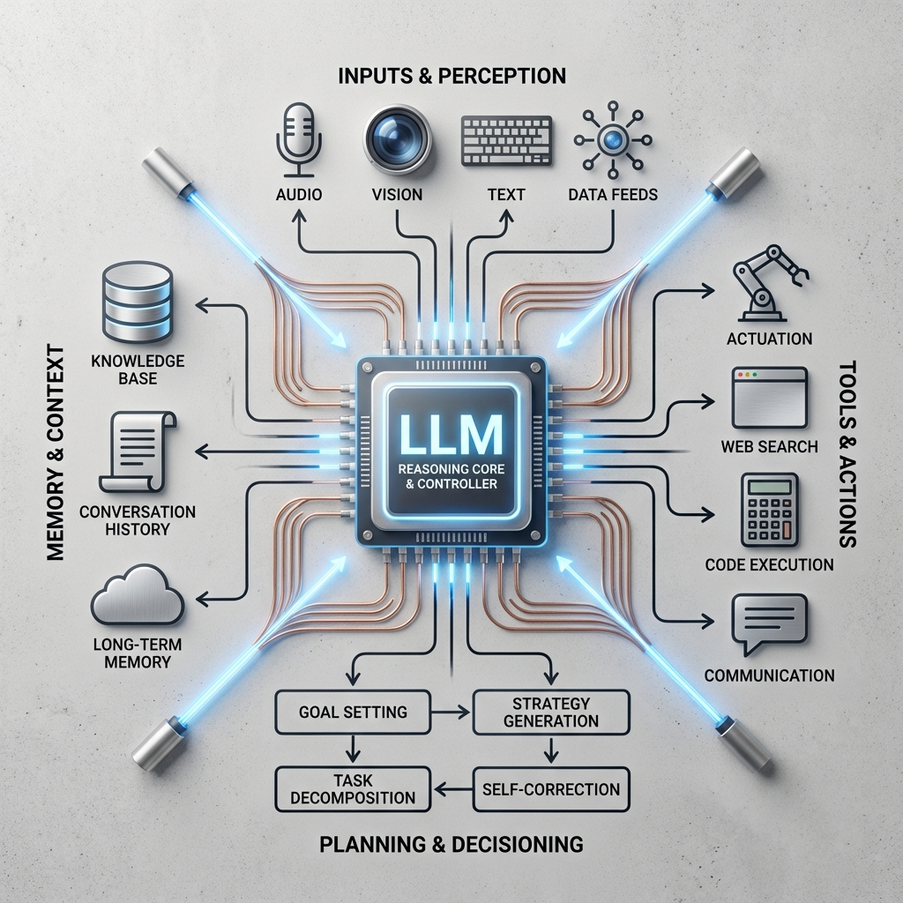
The Cognitive Engine
More Than Just Text
In an agentic system, the LLM stops being a simple chatbot and becomes the Reasoning Core.
It acts as the central controller that:
Parses user intent from ambiguous natural language.
Decomposes complex problems into steps.
Synthesizes data returned from those tools.

Slide 40
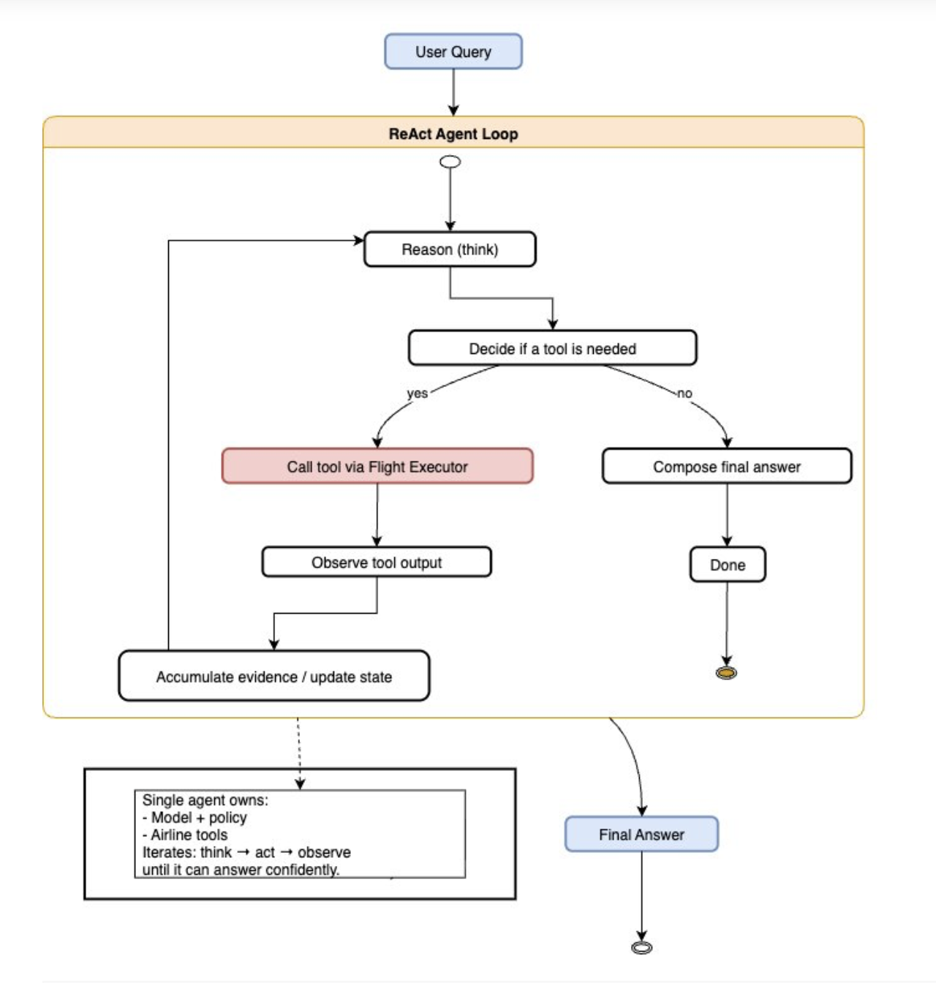
The ReAct Loop
Reasoning + Acting
The standard loop for modern agents is ReAct:
Thought: The agent analyzes the request.
Action: It decides which tool to call.
Observation: It reads the tool's output.
Repeat: It updates its thought process.
This cycle continues until the final answer is found.
Customize agent workflows with advanced orchestration techniques using Strands Agents | Artificial Intelligence
https://arxiv.org/abs/2210.03629

Slide 41
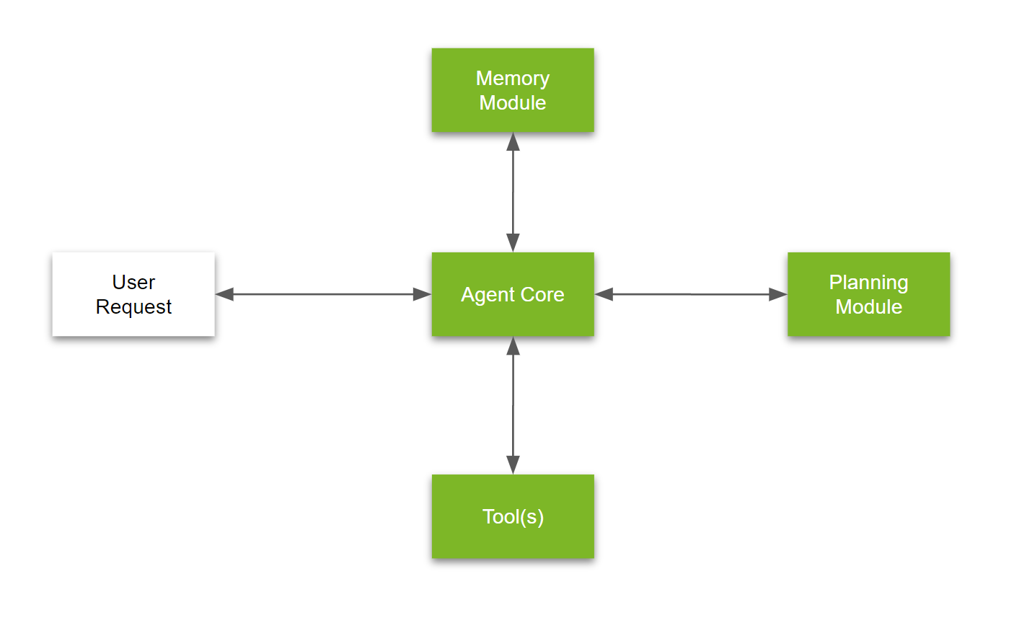
Anatomy of an Agent
A functional agent consists of four main modules:
The Brain (LLM): The decision-maker.
Planning: Breaking down complex goals.
Memory: Storing history and context.
Tools: Capabilities to interact with the world.
https://developer.nvidia.com/blog/introduction-to-llm-agents/

Slide 42







The Three Pillars of Agency
Planning
Memory
Tools
Decomposing goals into sub-tasks (Chain of Thought).
Vector Databases allow long-term recall of past events.
APIs, Calculators, and Search Engines extend capability.

Slide 43





Extending Capabilities with Tools
Web Browsing
Code Execution
External APIs
Accessing real-time information, news, and live data that is not in the training set.
Writing and running Python scripts to perform complex math or data analysis.
Interacting with services like Slack, Jira, or SQL databases to perform actions.

Slide 44


Memory: Short vs. Long Term
Short-Term (Context)
Long-Term (Vector Store)
The "RAM" of the Agent.
The "Hard Drive" of the Agent.
This is limited by the model's context window (e.g., 128k tokens). It holds the immediate conversation history, the current prompt, and recent tool outputs.
Uses Vector Databases (RAG) to store vast amounts of information. The agent retrieves only relevant "memories" based on semantic similarity to the current task.
Limitation: Cleared when the session ends.
Benefit: Infinite persistence.

Slide 45
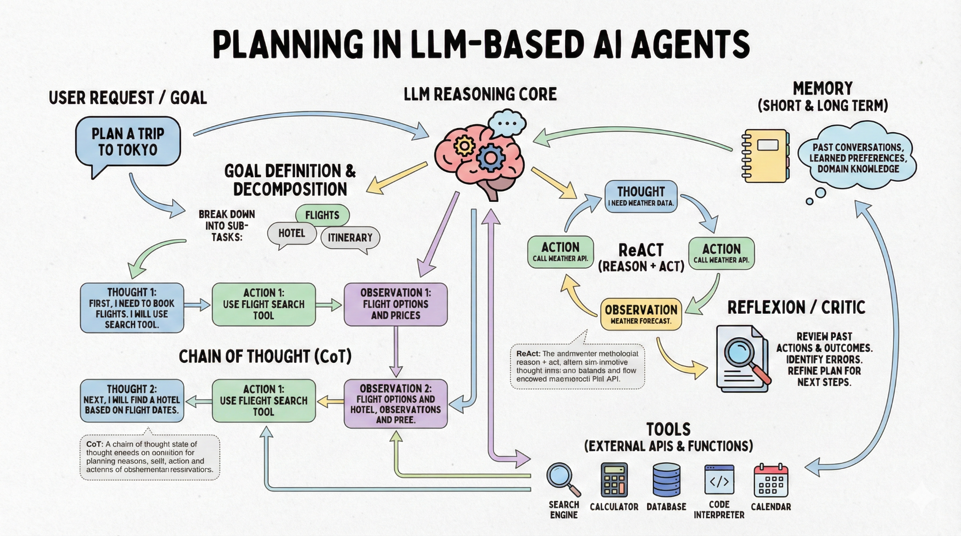
Planning & Reasoning
Breaking Down Complexity
Agents cannot solve complex tasks in one shot. They use planning techniques to improve reliability.
Chain of Thought: Stepping through logic explicitly.
Tree of Thoughts: Exploring multiple possibilities before committing.
Reflection: Reviewing past actions to catch errors.

Slide 46






The Future: Multi-Agent Systems
Specialization
Orchestration
Autonomy
Instead of one generalist, swarms of specialized agents (Coder, Designer, Writer) will collaborate.
"Manager" agents will break down huge projects and assign tasks to "worker" agents.
Agents will run continuously in the background, optimizing workflows without human input.

Slide 47
You’ve learned what agents can do.
Now let’s learn how to design them for real-world applications.

Slide 48
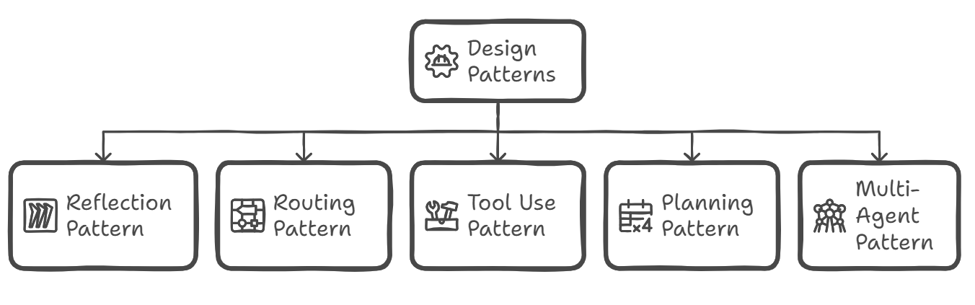
Agentic design Pattern
Agentic Design Patterns are the building blocks for LLM systems that go beyond single prompt–response interactions.
They use composable structures to orchestrate reasoning, decisions, tools, and control flow.
By replacing hard-coded logic with system structure, these patterns enable reliable adaptation and scaling—from simple assistants to autonomous, goal-driven agents.

Slide 49
Let’s build a CRM Lead qualifier agent
This README documents the complete agent design and routing logic for the CRM Lead Qualifier Agent

Slide 50

Feedback Poll for Instructor

Slide 51
Questions?
Exploring the frontier of autonomous AI.

Slide 52
For Instructors - Encourage Learner Interaction
Unmute learners and invite them to ask questions verbally
Promote open discussion instead of only chat-based Q&A
Actively engage learners to maintain interactivity throughout the session

Slide 53
After building your agent, package the project with proper documentation (README) and publish it on GitHub to showcase it in your portfolio.
README Template for Agentic 2.0

Slide 54
Build → Document → Publish (Every Agent)
For every agent built in this course:
Package the project with a clear, structured README
Upload it to your GitHub portfolio
Treat each agent as a standalone, portfolio-ready artifact
This workflow will be applied consistently in every class as agents are built and published.

Slide 55
Week 0 - Mini Project

Slide 56

Mini Project: Hello Agent – CSV FAQ Agent
The Challenge with Manual CSV Queries:
Many organizations store key knowledge in CSV files (FAQs, policies, docs).
Teams manually search these files during live conversations.
This leads to:
  Slow responses — information is hard to query quickly
  Inconsistent answers — different team members may interpret differently
  Inefficient workflows — time wasted on repetitive searches

Slide 57
Mini Project: Hello Agent – CSV FAQ Agent
CSV FAQ Agent Requirements:
CSV Upload: Users can upload one or more CSV files.
Natural Language Queries: Users can ask questions in plain English.
Data-Driven Answers: Responses are strictly based on the uploaded CSV data.
Missing Data Handling: Clearly indicate when an answer is not found in the data.

Slide 58
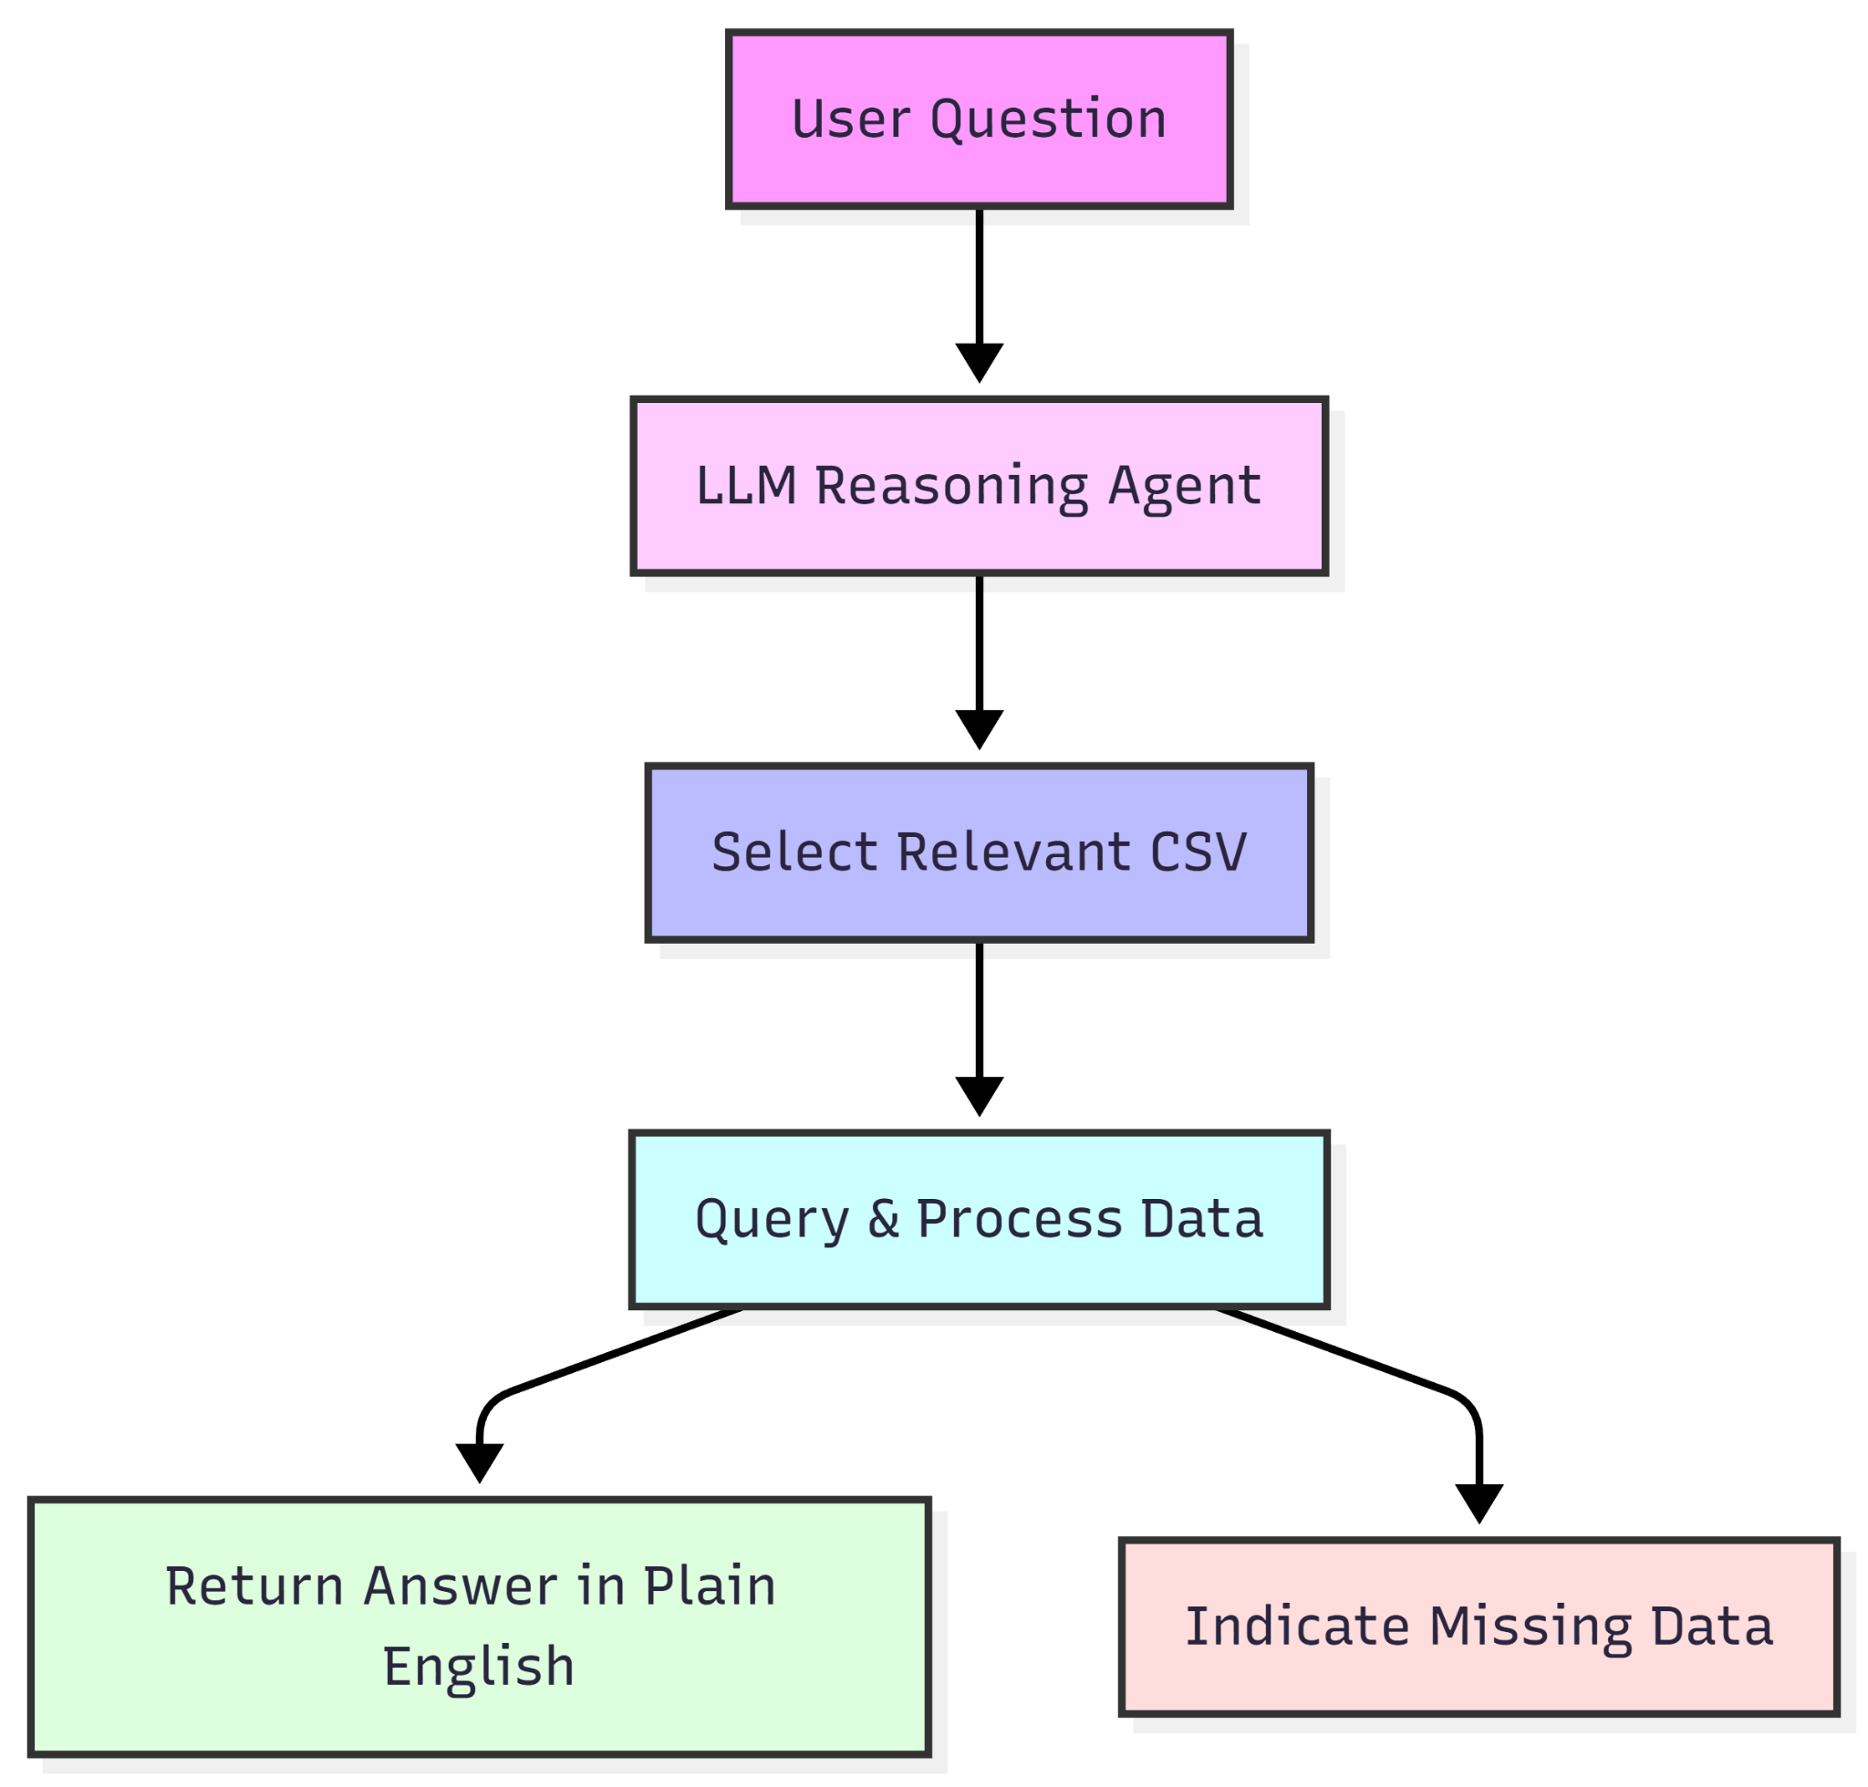
Hello Agent – CSV FAQ Agent: Solution
To solve the problem efficiently and meet the requirements:
Load all CSV files into memory for access.
Initialize an LLM agent (ChatOpenAI, GPT-4o-mini) to reason over data.
Connect multiple CSVs to the agent for multi-source decision making.
Design system prompts to guide the agent: pick the correct CSV, answer only from data, return plain English responses.
Implement a chat loop: user question → agent queries → returns answer or indicates missing data.
Let’s now look at the Solution

Slide 59


